Slide 1
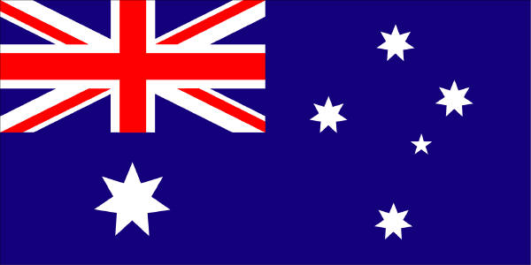
Australia’s Cultural Identity

Slide 2
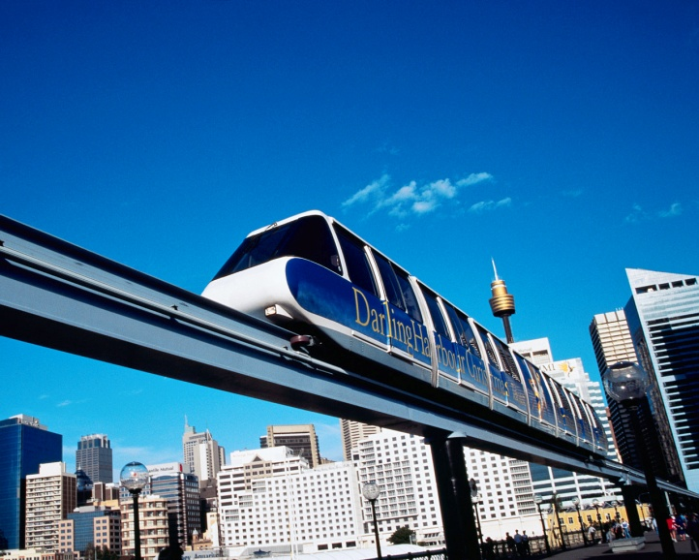
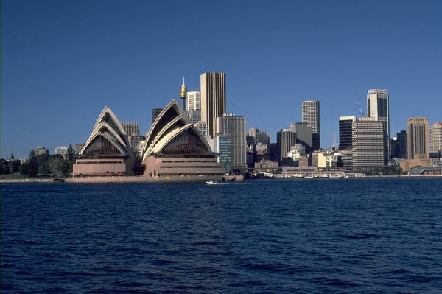
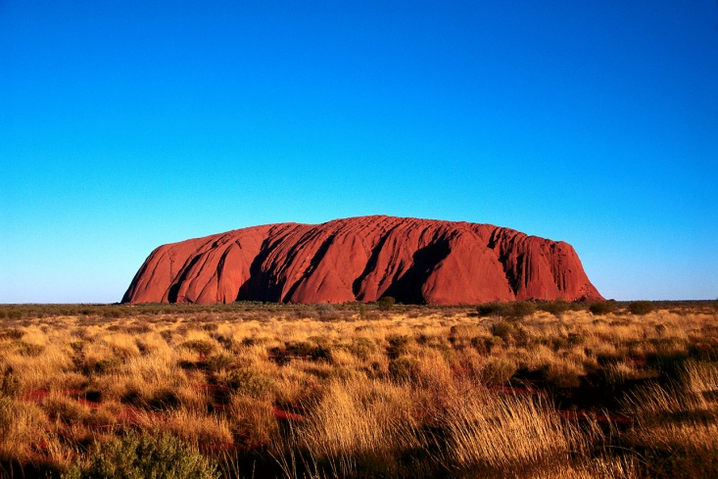
Landmarks
Australia has world famous landmarks that are instantly recognised as having social and cultural importance.
Some examples include:
Opera House
Sydney Harbor Bridge
Uluru
Can you think of any other examples?

Slide 3
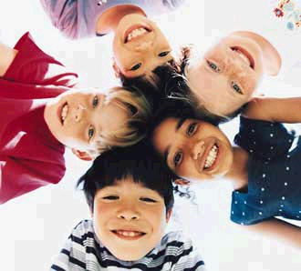
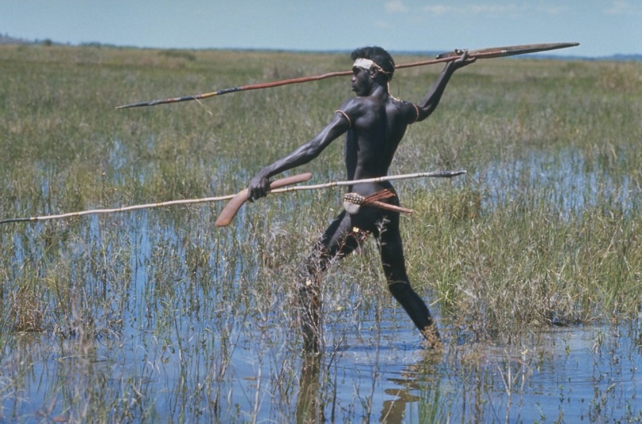
People
Australia is a multicultural country. Being a multicultural society means that Australia is made up of people from many different backgrounds.
Aboriginals
Italians
Chinese
Lebanese
How does being a multicultural society create an Australian identity?

Slide 4

Food
As Australia is multicultural this impacts on our food.
What are examples of traditional Australian foods?
What examples of food can you think of that make up a part of Australia’s cultural identity?

Slide 5

Celebrations
Australia has many days of celebrations. All these celebrations celebrate the Australian identity. Some are traditional and some are based on the multicultural make up of Australia.
Some examples include:
Australia Day
Anzac Day
Italian Festival, Leichardt
Greek Festival, Sydney
Why would Australians celebrate Italian and Greek Festivals?
What else do Australia’s celebrate? Why?
How does these celebrations make an Australiain identity?

Slide 6
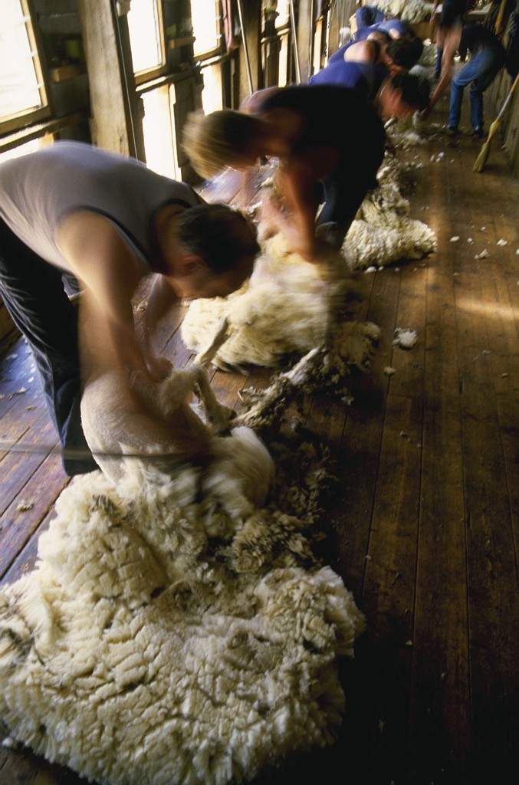
Industry
Australia has an important part in industry.
Can you think of any examples of Australia industry?
What role does this play in Australia’s identity?

Slide 7

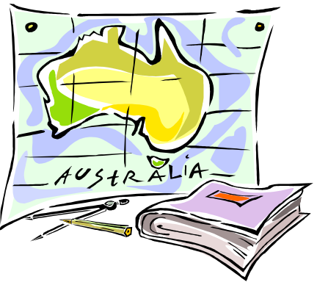
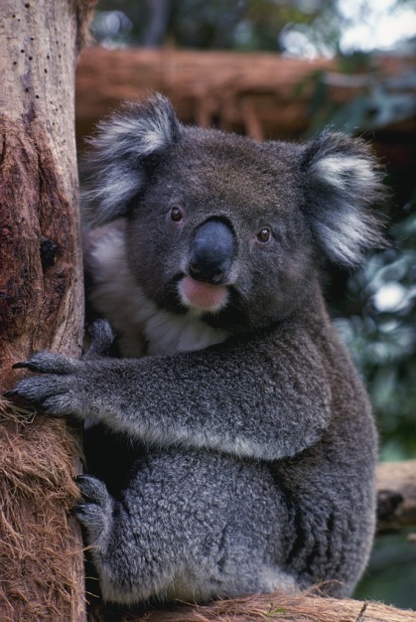
Symbols
Australia has many symbols. These symbols are signs and images that are unique to Australia. These symbols help create a picture of Australia’s identity in the global world.
Some examples include:
Opera House
Australian Flag
National Anthem
What other symbols can you think of?

Slide 8

Sport
What examples of sport can you think of that make up a part of Australia’s cultural identity?

